Slide 1
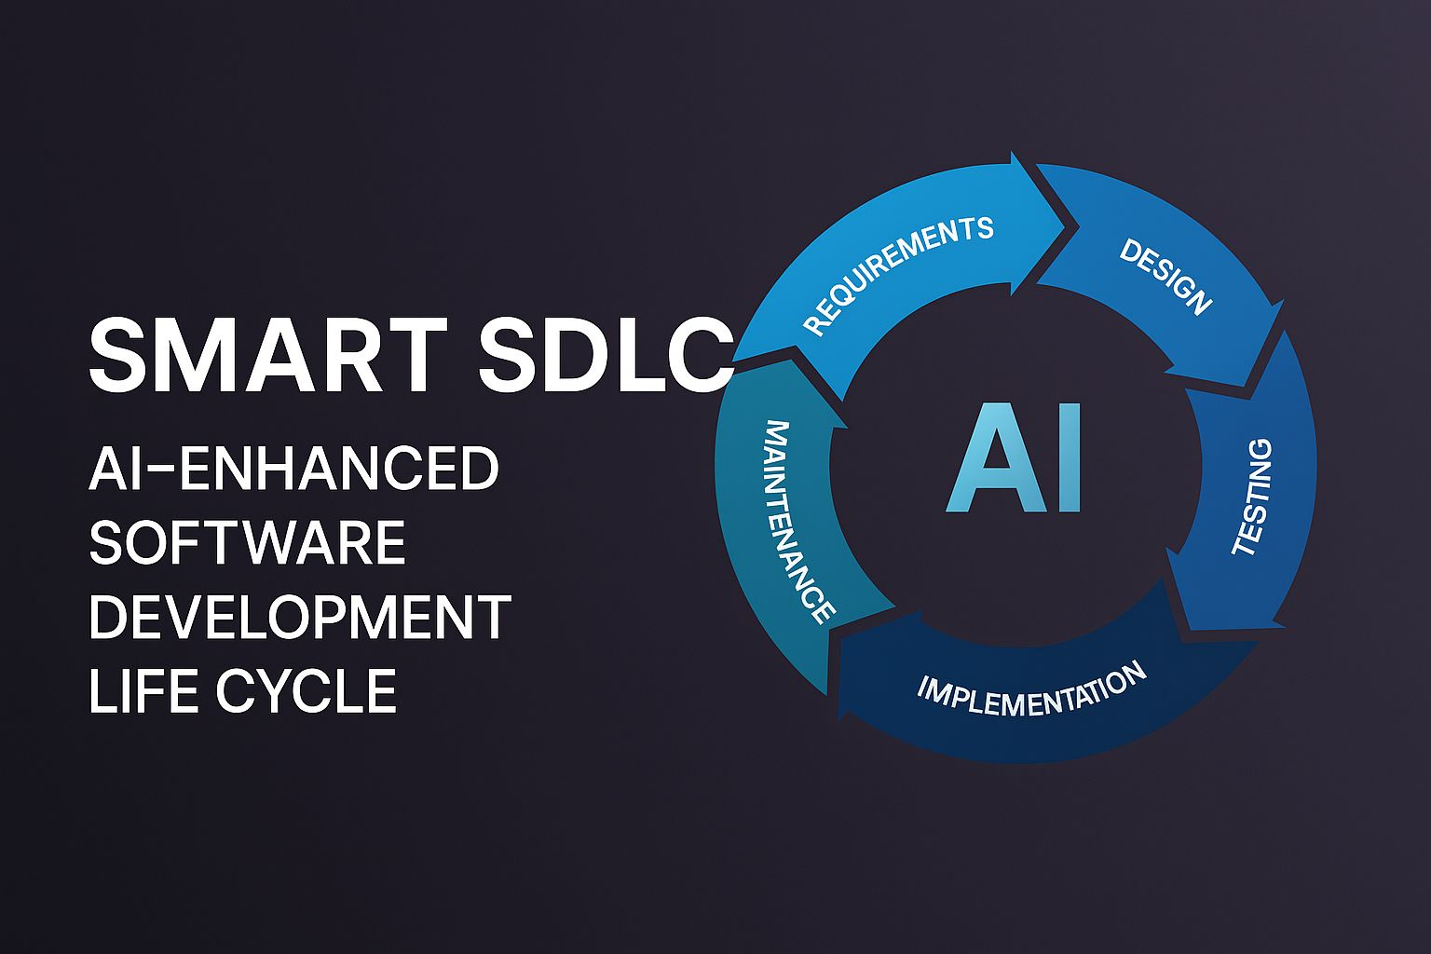

Slide 2
Team Members
Kamalidhara K
Durga devi K
Jayasri B
Vaishnavi p
Introduction
Software Development Life Cycle (SDLC). Traditionally, SDLC includes phases like planning, designing, coding, testing, and maintenance.Today, with the help of Artificial Intelligence (AI), this process is becoming faster and smarter. A Smart SDLC uses AI tools to help with tasks such as writing code, finding bugs, testing software, and predicting problems before they happen. This makes software development more efficient, reduces errors, and saves time.In this project, we explore how AI can improve each phase of the SDLC and how it can help developers build better software more easily and quickly.
Project Overview
This project focuses on the development and benefits of a Smart Software Development Life Cycle (SDLC) that is enhanced with Artificial Intelligence (AI) tools and technologies. The goal is to understand how AI can be integrated into each phase of the SDLC to make software development faster, more efficient, and less error-prone.
In traditional SDLC models, many tasks such as writing code, testing, and debugging are done manually, which can be time-consuming and prone to human error. By using AI, these tasks can be automated or improved through smart suggestions, pattern recognition, and predictive analytics.
This project highlights how AI can:
Analyze and understand requirements more accurately
Generate code automatically or assist developers in writing better code
Perform intelligent testing and identify bugs early
Predict project risks and suggest improvements
Help maintain and update software more effectively
By implementing a Smart SDLC, organizations can save time, reduce costs, and deliver high-quality software faster.

Slide 3
Architecture
AI in Requirements Gathering
Tools: NLP, AI chatbots
Automatically analyze user input, extract features, and detect inconsistencies.
AI in System Design
AI recommends architecture patterns or reusable components based on previous projects or best practices.
AI in Coding
Tools: GitHub Copilot, Tabnine
AI helps generate code snippets, suggest optimizations, and follow coding standards.
AI in Testing
Tools: Testim, Applitools
Smart test case generation, automatic bug detection, and prioritization of test cases using AI.
AI in Deployment & Maintenance
Tools: AIOps platforms (e.g., Moogsoft, Dynatrace)
Monitors system behavior, predicts failures, and suggests fixes before issues affect users.
Continuous Feedback Loop
AI/ML algorithms analyze feedback from all stages to improve future development cycles.
Setup Instruction
Open Google Colab
Go to Runtime → Change runtime type → Select GPU
Install required libraries: Gradio and Transformers
Import the IBM Granite model from Hugging Face
Create a Gradio interface for user input and output
Run all cells in the Colab notebook
Click the Gradio link to open and test your app
Save your Colab notebook to Google Drive
(Optional) Use GitHub to manage and share your project

Slide 4
Authentication
Authentication means checking a user’s identity before giving access to the system. It helps keep the project secure by allowing only authorized users to use or manage it.
Common methods include usernames and passwords, API keys, or secure login systems.
User Interface
A User Interface (UI) is the part of a software or app that users see and interact with. It includes things like buttons, text boxes, menus, and screens.
UI helps users enter input (like text) and see the output (like AI-generated results) easily.
A good UI is:
Easy to use
Clear and simple
Visually clean
Testing
Testing means checking if your software or app works correctly. It helps find and fix mistakes (called bugs) before the project is used by others.
The AI gives the right output
The buttons and inputs work properly
The whole system runs without errors
Testing helps make the software reliable, safe, and easy to use.

Slide 5
Known Issues
Known issues are the problems in the project that we already know about. They are not fixed yet.
Example:
Some parts may not work properly
The app might be slow sometimes
AI may give wrong or incomplete answers
These issues can be fixed in the future.
Future Enhancements
In the future, the Smart SDLC project can be improved in many ways to make it more useful, efficient, and user-friendly. Some planned enhancements include:
Better AI Models – Use more advanced AI to improve accuracy in code generation and testing.
Improved User Interface – Make the interface more interactive and easier to use.
User Authentication – Add login and role-based access for better security.
Integration with DevOps Tools – Connect with tools like GitHub and Jenkins for smoother workflows.
Real-Time Collaboration – Allow multiple users to work on the same project at the same time.
These enhancements will make the system smarter, faster, and ready for real-world use.

Slide 6
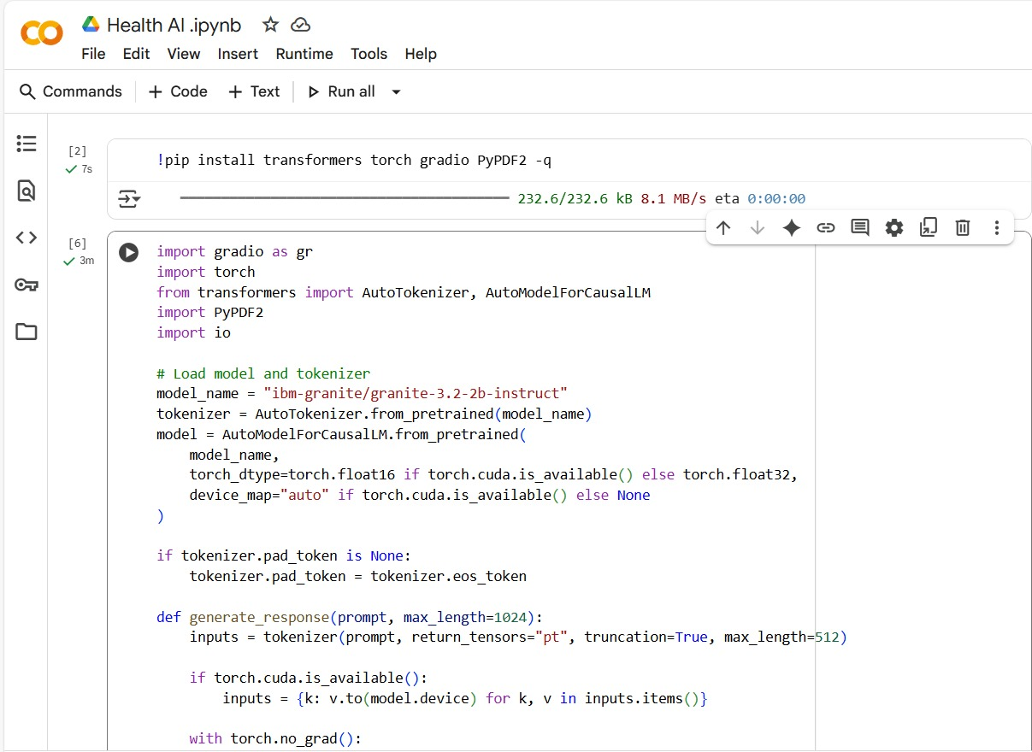
Project Screenshot

Slide 7
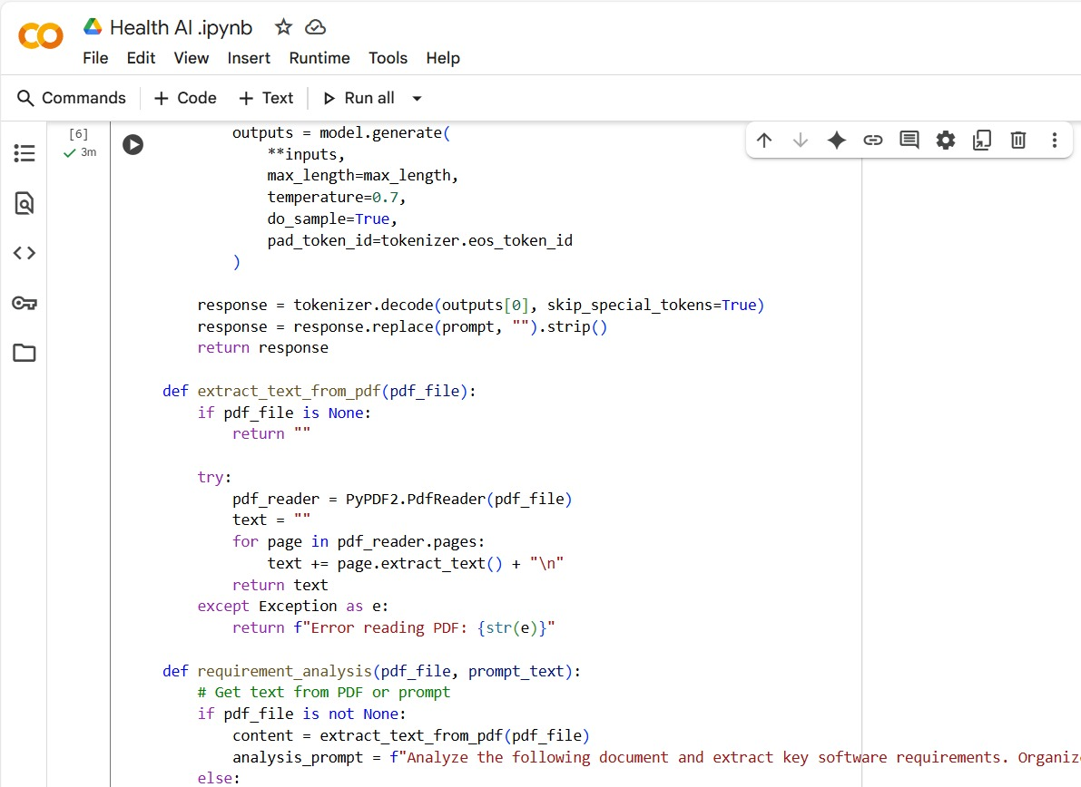
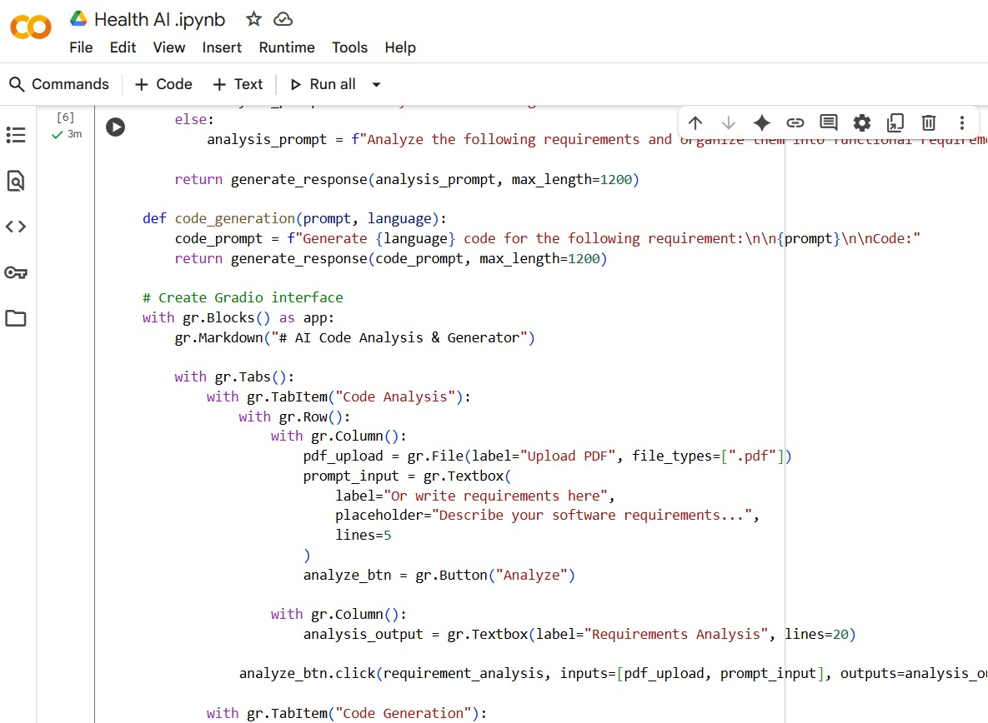

Slide 8
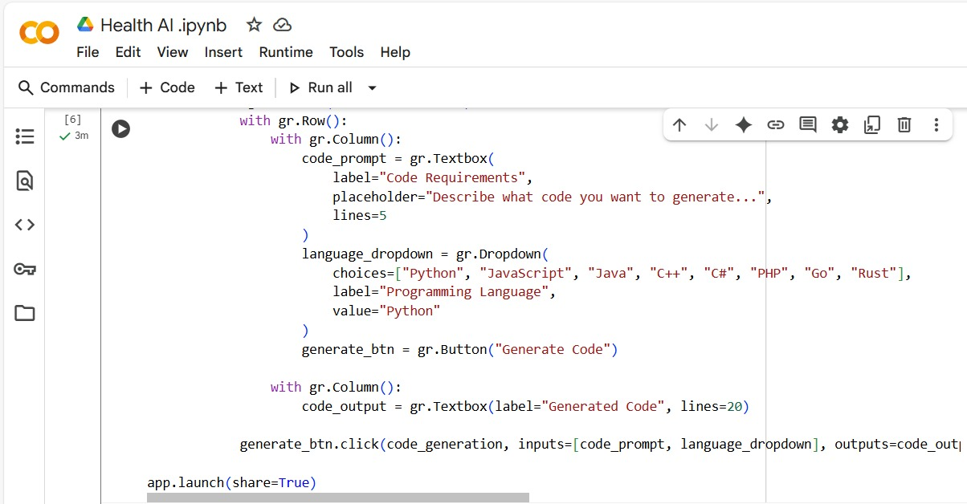
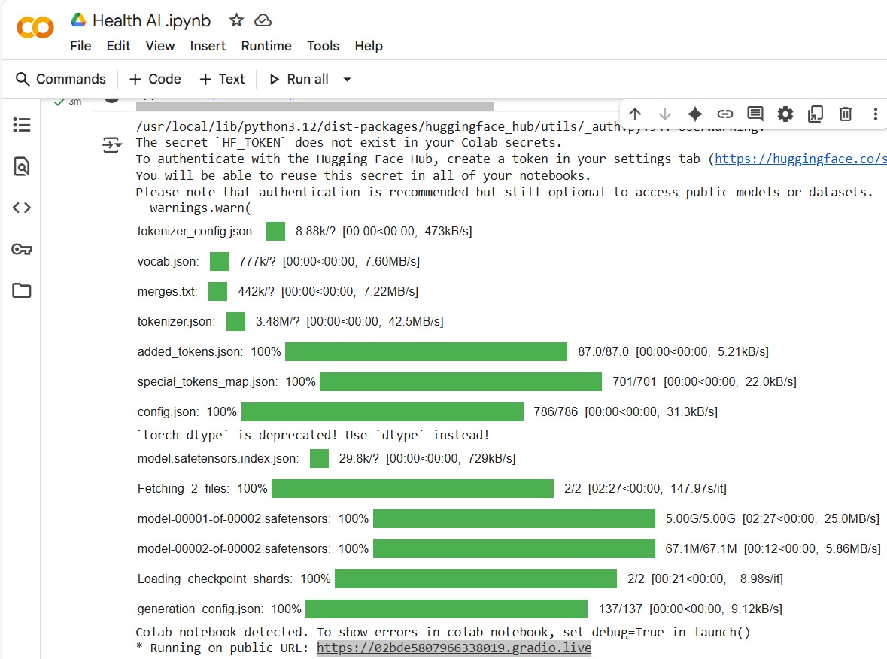

Slide 9
Thank you

